Slide 1
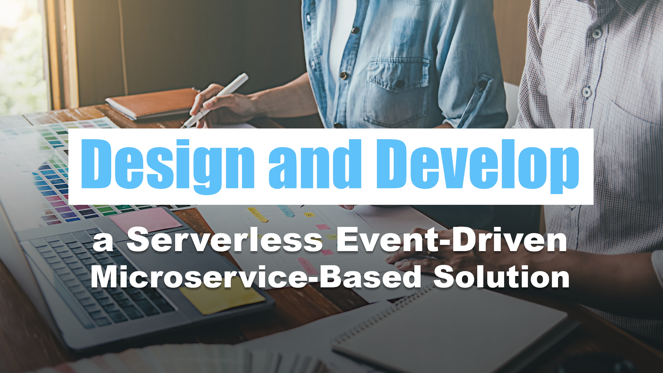
05 – Azure Service Introductions

Slide 2
Azure Service Introductions
Design and Develop a Serverless Event-Driven Microservice-Based Solution

Slide 3

Azure SQL
Notes:
Azure SQL, also known as Microsoft Azure SQL Database, is a cloud-based relational database service offered by Microsoft as part of its Azure cloud computing platform. It is a fully managed database service that allows you to host, manage, and scale relational databases in the cloud without the need to set up and maintain physical hardware or manage the database software yourself.
Azure SQL Database is based on Microsoft SQL Server, which is a popular and powerful relational database management system (RDBMS). It provides a range of features and capabilities for building and managing applications that rely on a relational database, including data storage, data retrieval, and data processing.

Slide 4
Key Features
Scalability
High availability
Security
Automated management
Compatibility
Global distribution
Integration with other Azure services
Notes:
Scalability: Azure SQL Database can be easily scaled up or down to meet the performance and capacity needs of your applications. You can choose from various service tiers with different levels of compute and storage resources.
High availability: Azure SQL Database offers built-in high availability and automated backups to ensure that your data is always accessible and protected from data loss.
Security: It provides robust security features, including firewall rules, encryption, threat detection, and authentication, to help protect your data.
Automated management: Many routine database management tasks, such as patching and maintenance, are handled automatically by the Azure platform, reducing the operational overhead.
Compatibility: Azure SQL Database is compatible with many Microsoft SQL Server features and tools, making it relatively easy to migrate existing on-premises SQL Server databases to the cloud.
Global distribution: You can deploy Azure SQL Database in multiple Azure regions for data redundancy and low-latency access from different parts of the world.
Integration with other Azure services: Azure SQL Database can be integrated with other Azure services like Azure Logic Apps, Azure Functions, and Azure App Service, making it suitable for a wide range of cloud-based applications.

Slide 5
Purchasing Models
DTU
vCore
Notes:
The DTU-based purchasing model offers a blend of compute, memory, and I/O resources in three service tiers to support light to heavy database workloads. Compute sizes within each tier provide a different mix of these resources, to which you can add additional storage resources.
The vCore-based purchasing model lets you choose the number of vCores, the amount of memory, and the amount and speed of storage.

Slide 6
Service Tiers
DTU
Basic
Standard
Premium
vCore
General Purpose
Business Critical
Hyperscale
Notes:
DTU
Basic
Standard – Designed for common workloads; offers budget-oriented balanced compute and storage options
vCore
General Purpose – designed for common workloads; offers budget-oriented balanced compute and storage options
Business Critical – designed for OLTP application with high transaction rates and low latency I/O requirements; offers the highest resilience to failures by using several isolated replicas
Hyperscale – designed for most business workloads; provide great flexibility and high performance with independently scalable compute and storage resources; offers higher resilience to failures by allowing configuration of more than one isolated database replicate

Slide 7
Compute Tiers
Provisioned
Serverless
Notes:
Provisioned compute tier provides a specific amount of compute resource that is continuously provisioned implemented of workload activity, and bills for the amount of compute provisioned at a fixed price per hour.
Serverless compute tier automatically scales compute resources based on workload activity and bills for the amount of compute used, per second.

Slide 8
Deployment Models
Single Database
Elastic Pool
Notes:
Single database represents a fully managed, isolated database.
Elastic pool is a collection of single databases with a shared set of resources, such as CPU or memory. Single databases can be moved into and out of an elastic pool

Slide 9

Azure Cosmos DB

Slide 10





Azure Cosmos DB
Core (SQL) API
Table API
MongoDB
Column-family
Document
Key-value
Graph
Guaranteed low latency at the 99th percentile
Elastic scale out
of storage & throughput
Five well-defined consistency models
Turnkey global distribution
Comprehensive SLAs
Notes:
Turnkey global distribution
Elastic scale out of storage & throughput
Guaranteed low latency at the 99th percentile
Five well-defined consistency models
Comprehensive SLAs
The right data model for you use
Different Cosmos APIs to meet your needs

Slide 11
Which Azure Cosmos DB Data API?
NoSQL
NoSQL

Slide 12

Which Azure Cosmos DB Data API?
NoSQL
MongoDB

Slide 13

Which Azure Cosmos DB Data API?
NoSQL
Table Storage

Slide 14
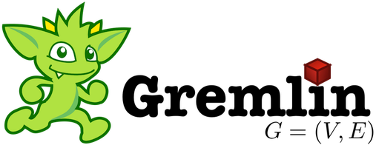
Which Azure Cosmos DB Data API?
NoSQL
Gremlin

Slide 15
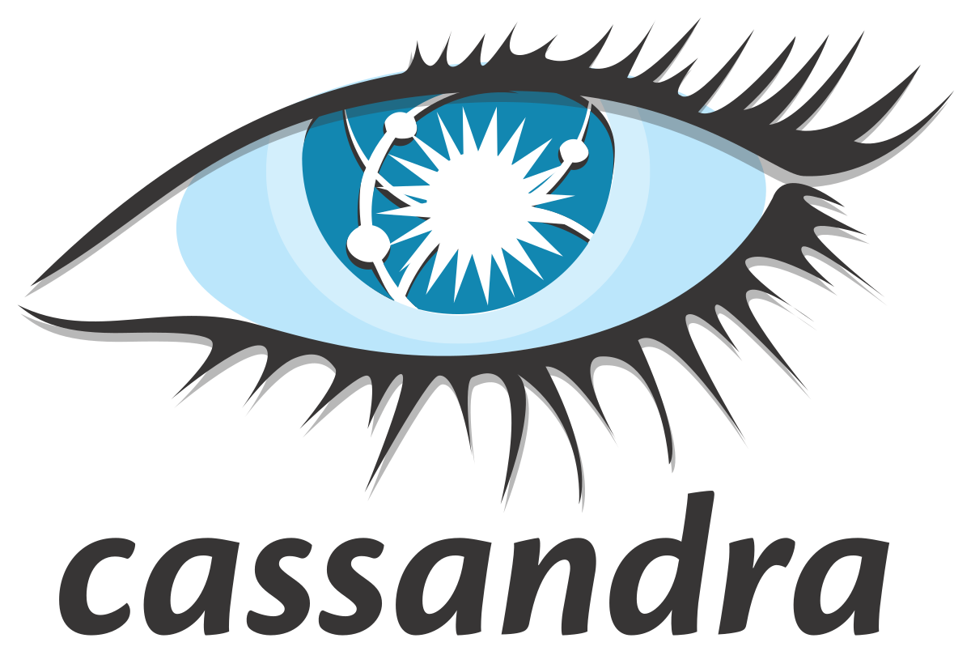
Which Azure Cosmos DB Data API?
NoSql
Cassandra

Slide 16

Azure Event Hubs
Notes:
Azure Event Hubs is a cloud native data streaming service that can stream millions of events per second, with low latency, from any source to any destination. Event Hubs is compatible with Apache Kafka, and it enables you to run existing Kafka workloads without any code changes.

Slide 17




Why choose Event Hubs?
Simple
Secure
Scalable
Open
Notes:
Simple – Build real-time data pipelines with just a couple clicks. Seamlessly integrate with Azure data services to uncover insights faster.
Secure – Protect your real-time data. Event Hubs is certified by CSA, STAR, ISO, SOC, GxP, HIPPA, HITRUST, and PCI.
Scalable – Adjust throughput dynamically based on your usage needs and pay only for what you use.
Open – Ingest data from anywhere and develop across platforms with support for popular protocols, including AMQP, HTTPS, and Apache Kafka.

Slide 18

Key Architecture Components
Event Producers
Notes:
Event Producers – Any entity that sends data to an even hub. Event publishers can publish events using HTTPS or AMQP 1.0 or Apache Kafka (1.0 and above).

Slide 19
Key Architecture Components
Partitions
Notes:
Partitions – Each consumer only reads a specific subset, or partition, of the message stream.
Event Hubs provides message streaming through a partitioned consumer pattern in which each consumer only reads a specific subset, or partition, or the message stream. This pattern enables horizontal scale for event processing and provides other stream-focused features that are unavailable in queues and topics.
A partition is an ordered sequence of events that is held in an event hub. As newer events arrive, they are added to the end of this sequence. A partition can be thought of as a “commit log.
Event Hubs retain data for a configured retention time that applies across all partitions in the event hub. Events expire on a time basis; you cannot explicitly delete them. <CLICK> Because partitions are independent and contain their own sequence of data, they often grow at different rates.
The number of partitions is specified at creation and must be between 2 and 32. The partition count is not changeable, so you should consider long-term scale when setting partition count.
Recommendation is to balance 1:1 throughput units and partitions to achieve optimal scale.

Slide 20
Key Architecture Components
Consumer Groups
Notes:
Consumer Groups – A view (state, position, or offset) of an entire event hub. Consumer groups enable consuming applications to each have a separate view of the event stream. They read the stream independently at their own pace and with their own offsets.

Slide 21
Key Architecture Components
Throughput Units
Notes:
Throughput Units – Pre-purchased units of capacity that control the throughput capacity of Event Hubs.
A single throughput unit lets you:
Ingress: Up to 1-Mb per second or 1000 events per second (which ever comes first)
Egress: Up to 2-Mb per second or 4096 events per second
ServerBusyException thrown
The Auto-Inflate feature automatically scales up by increasing the number of throughput units, to meet usage needs. Increasing throughput units prevents throttling scenarios

Slide 22
Key Architecture Components
Event Receivers
Notes:
Event Receivers – Any entity that reads event data from an event hub. All Event Hubs consumers connect via the AMQP 1.0 session. The Event Hubs service delivers events through a session as they become available. All Kafka consumers connect via the Kafka protocol 1.0 and later.

Slide 23

Azure Service Bus
Notes:
Azure Service Bus is a fully managed enterprise message broker with message queues and publish-subscribe topics (in a namespace). Service Bus is used to decouple applications and services from each other, providing the following benefits:
Load-balancing work across competing workers
Safely routing and transferring data and control across service and application boundaries
Coordinating transactional work that requires a high-degree of reliability

Slide 24
Common Messaging Scenarios
Messaging
Notes:
Data is transferred between different applications and services using messages. A message is a container decorated with metadata, and contains data. The data can be any kind of information, including structured data encoded with the common formats such as the following ones: JSON, XML, Apache Avro, Plain Text.
Some common messaging scenarios are:
Messaging. Transfer business data, such as sales or purchase orders, journals, or inventory movements.

Slide 25
Common Messaging Scenarios
Messaging
Decouple applications
Notes:
Decouple applications. Improve reliability and scalability of applications and services. Producer and consumer don't have to be online or readily available at the same time. The load is leveled such that traffic spikes don't overtax a service.

Slide 26
Common Messaging Scenarios
Messaging
Decouple applications
Load balancing
Notes:
Topics and subscriptions. Enable 1:n relationships between publishers and subscribers, allowing subscribers to select particular messages from a published message stream.

Slide 27
Common Messaging Scenarios
Messaging
Decouple applications
Load balancing
Transactions
Notes:
Transactions. Allows you to do several operations, all in the scope of an atomic transaction. For example, the following operations can be done in the scope of a transaction.
Obtain a message from one queue.
Post results of processing to one or more different queues.
Move the input message from the original queue.
The results become visible to downstream consumers only upon success, including the successful settlement of input message, allowing for once-only processing semantics. This transaction model is a robust foundation for the compensating transactions pattern in the greater solution context.

Slide 28
Common Messaging Scenarios
Messaging
Decouple applications
Load balancing
Transactions
Message sessions
Notes:
Message sessions. Implement high-scale coordination of workflows and multiplexed transfers that require strict message ordering or message deferral.

Slide 29
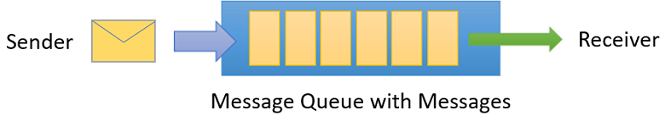
Key Concepts
Queues
Notes:
Messages are sent to and received from queues. Queues store messages until the receiving application is available to receive and process them.
Messages in queues are ordered and timestamped on arrival. Once the broker accepts the message, the message is always held durably in triple-redundant storage, spread across availability zones if the namespace is zone-enabled. Service Bus keeps messages in memory or volatile storage until they've been reported by the client as accepted.
Messages are delivered in pull mode, only delivering messages when requested. Unlike the busy-polling model of some other cloud queues, the pull operation can be long-lived and only complete once a message is available.

Slide 30
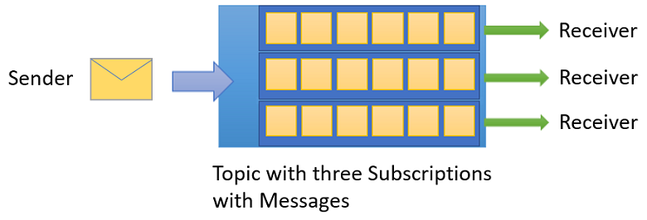
Key Concepts
Queues
Topics
Notes:
Topics can have multiple, independent subscriptions, which attach to the topic and otherwise work exactly like queues from the receiver side. A subscriber to a topic can receive a copy of each message sent to that topic. Subscriptions are named entities. Subscriptions are durable by default, but can be configured to expire and then be automatically deleted. Via the Java Message Service (JMS) API, Service Bus Premium also allows you to create volatile subscriptions that exist for the duration of the connection.
You can define rules on a subscription. A subscription rule has a filter to define a condition for the message to be copied into the subscription and an optional action that can modify message metadata. For more information, see Topic filters and actions. This feature is useful in the following scenarios:
You don't want a subscription to receive all messages sent to a topic.
You want to mark up messages with extra metadata when they pass through a subscription.

Slide 31

Azure Communication
Services
Notes:
Azure Communication Services are cloud-based services with REST APIs and client library SDKs available to help you integrate communication into your applications. You can add communication to your applications without being an expert in underlying technologies such as media encoding or telephony.

Slide 32
Services
SMS
Notes:
Azure Communication Services enables you to send and receive SMS text messages using the Communication Services SMS SDKs. These SDKs can be used to support customer service scenarios, appointment reminders, two-factor authentication, and other real-time communication needs. Communication Services SMS allows you to reliably send messages while exposing deliverability and response metrics.

Slide 33
Services
SMS
Calling
Notes:
The Calling SDK enables end-user devices to drive voice and video communication experiences.

Slide 34
Services
SMS
Calling
Telephony
Notes:
Azure Communication Services Calling SDKs can be used to add telephony and Public Switched Telephone Network access to your applications.

Slide 35
Services
SMS
Calling
Telephony
Chat
Notes:
Azure Communication Services Chat can help you add real-time text communication to your cross-platform applications.

Slide 36
Services
SMS
Calling
Telephony
Chat
Email
Notes:
Azure Communication Services Chat can help you add real-time text communication to your cross-platform applications.

Slide 37
Services
SMS
Calling
Telephony
Chat
Email
Network Traversal
Notes:
Real-time Relays solve the problem of NAT (Network Address Translation) traversal for Peer-to-Peer (P2P) connections. Most devices on the internet today have an IP address used for internal LAN traffic (home or corporate network) or an externally visible address (router or NAT gateway). To connect two devices on the internet, the external address is required, but is typically not available to a device behind a NAT gateway. To address the connectivity issue, following protocols are used:
STUN (Session Traversal Utilities for NAT) offers a protocol to allow devices to exchange external IPs on the internet. If the clients can see each other, there is typically no need for a relay through a TURN service since the connection can be made peer-to-peer. A STUN server's job is to respond to request for a device's external IP.
TURN (Traversal Using Relays around NAT) is an extension of the STUN protocol that also relays the data between two endpoints through a mutually visible server.

Slide 38
Services
SMS
Calling
Telephony
Chat
Email
Network Traversal
WhatsApp
Notes:
Azure Communication Services enables you to send and receive WhatsApp messages using the Azure Communication Services Messaging SDK. This SDK can be used to engage in conversation with a customer for product inquiry and customer service scenarios. It can also be used to send out messages like appointment reminders, shipping updates, two-factor authentication, and other notification scenarios.

Slide 39

Azure Functions
Notes:
Azure Functions is a cloud service available on-demand that provides all the continually updated infrastructure and resources needed to run your applications. You focus on the code that matters most to you, in the most productive language for you, and Functions handles the rest. Functions provides serverless compute for Azure. You can use Functions to build web APIs, respond to database changes, process IoT streams, manage message queues, and more.

Slide 40


Code
Events + data

Slide 41
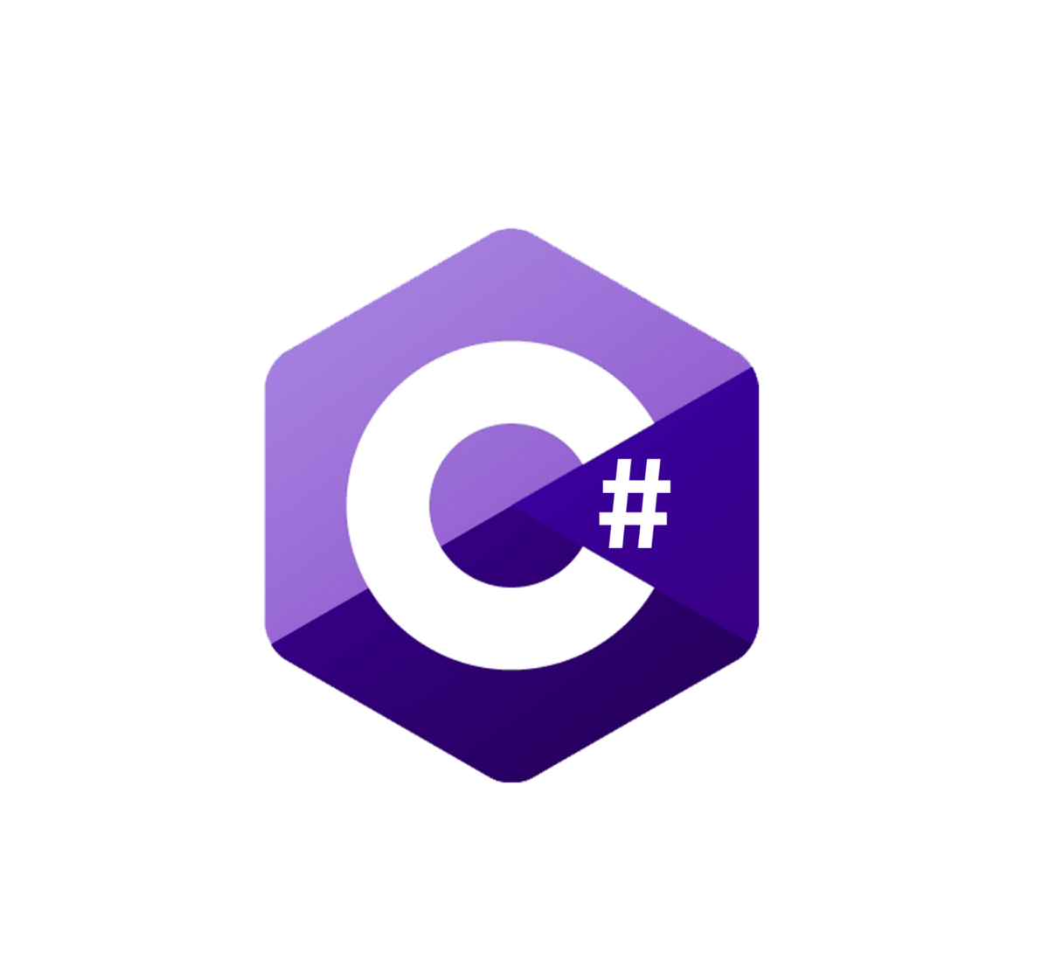






Choice of Language
Notes:
Choice of language: Azure Functions is a polyglot solution which allows you to write functions in not just C#, F#, and JavaScript, but also Java, Python, TypeScript, and even PowerShell
TypeScript supported through transpiling to JavaScript

Slide 42


Bring your own dependencies
Notes:
Bring your own dependencies: Functions support both NuGet and NPM, so you can use your favorite libraries.

Slide 43









Simplified Integration
Notes:
Simplified integration: Easily leverage Azure services and software-as-a-service (SaaS) offerings. These services can trigger your function and start execution or they can serve as input and output for your code.
Such services include Cosmos DB, Event Hubs, Event Grid, Mobile Apps, Notification Hubs, Service Bus, Azure Storage, GitHub, and Twilio SMS messages
Azure Services
CosmosDB
Event Hubs
Event Grid
Notifications Hub
Azure Storage (blob, queue)
3rd Party Services
RabbitMQ
GitHub
Twillio

Slide 44

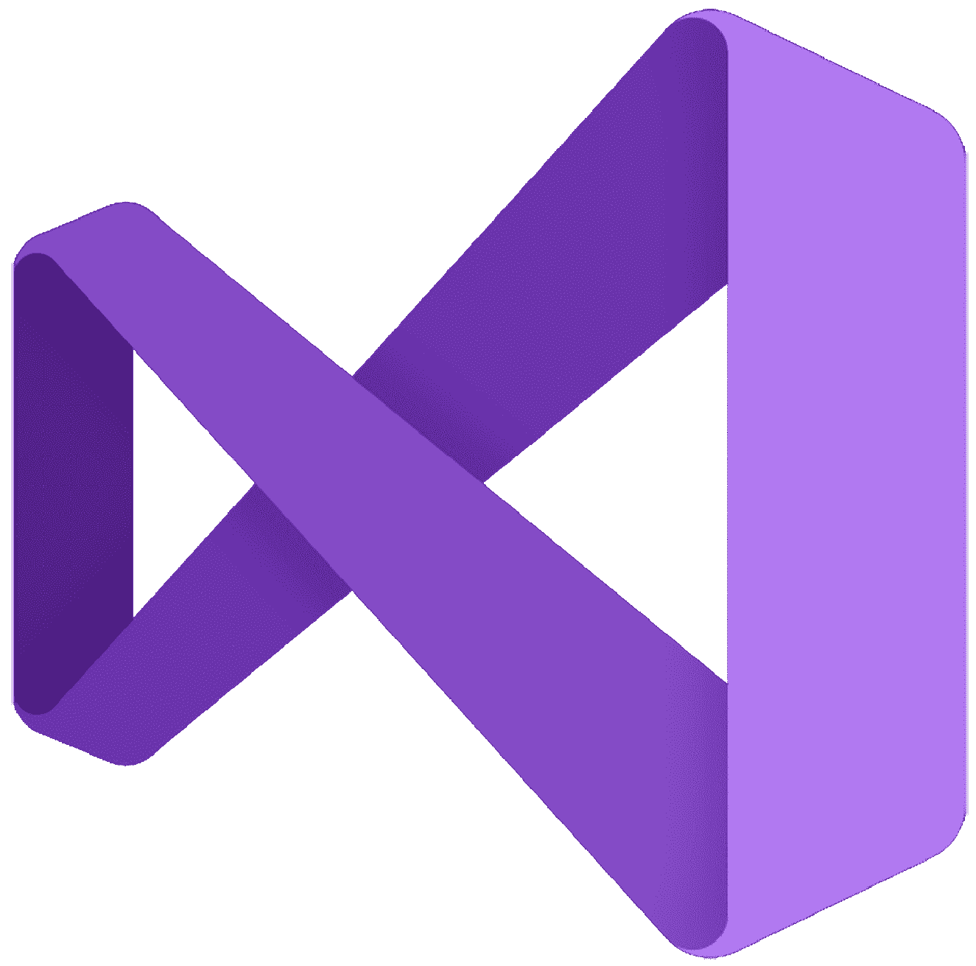

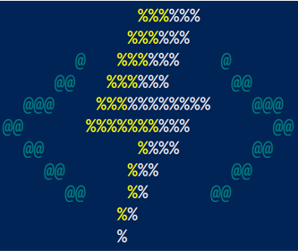


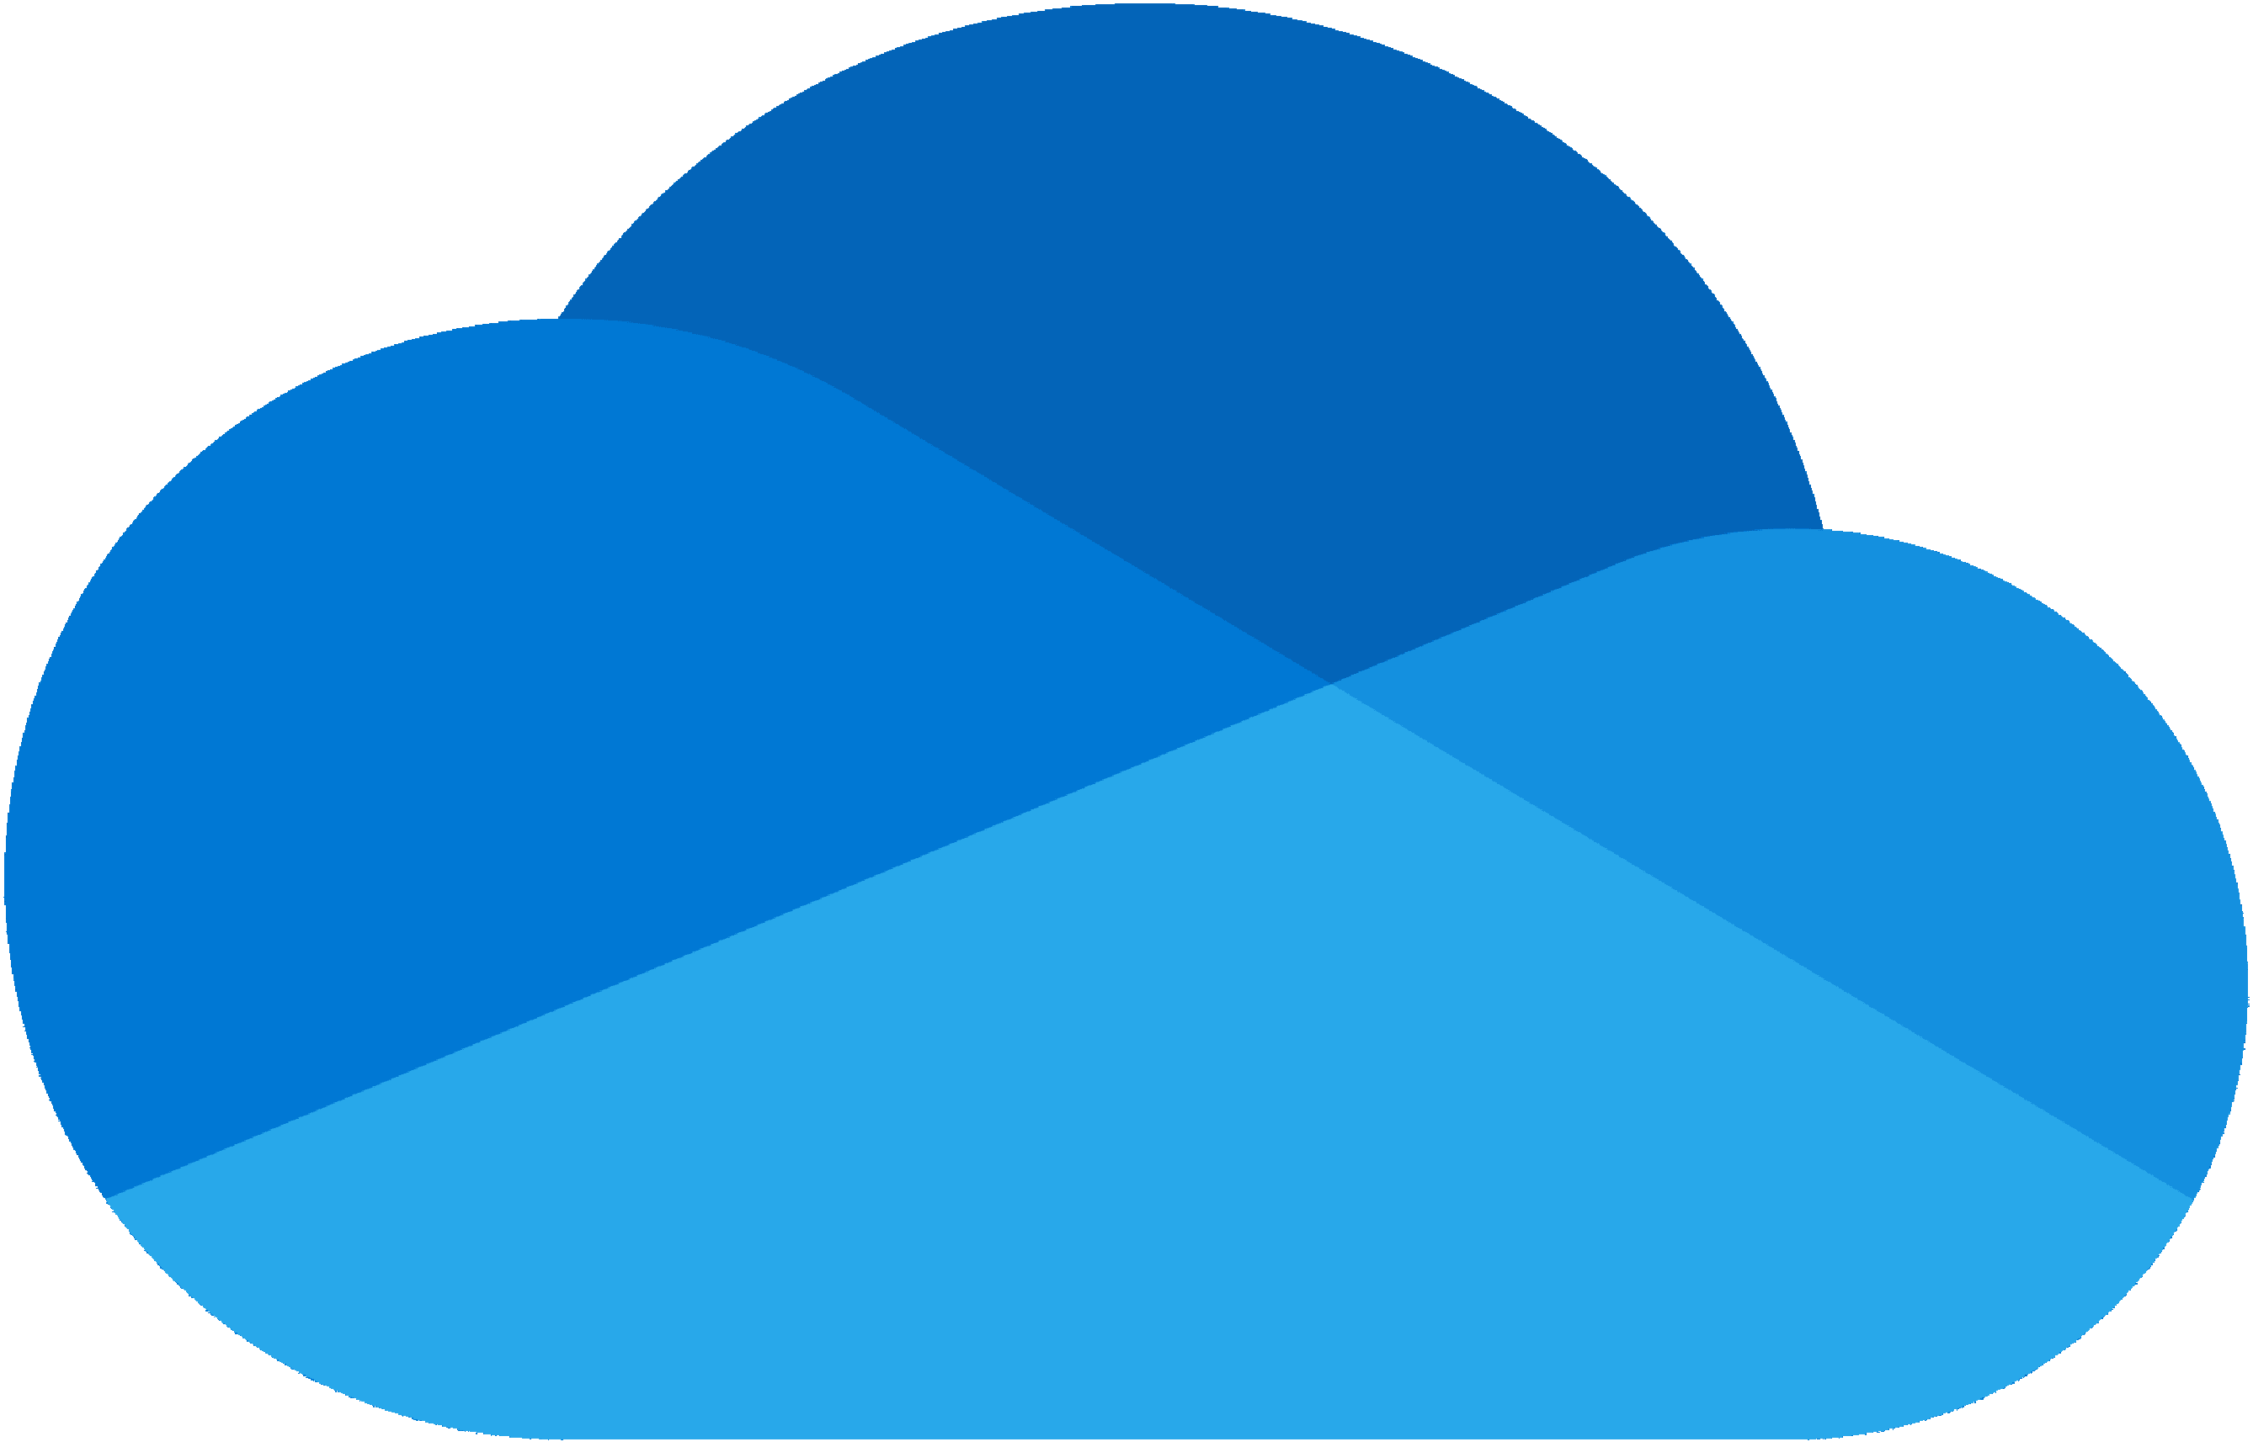




Flexible Development
Notes:
Flexible development: Code your functions right in the portal or set up continuous integration and deploy your code through GitHub, Visual Studio Team Services, and other support development tools including OneDrive, Bitbucket, Dropbox, and either a local or external Git repository

Slide 45
Many Deployment Options
Consumption
Serverless
Notes:
Pay only for what you use! Metering is per execution and per Gb second.

Slide 46

Many Deployment Options
App Service
Plan
Consumption
Serverless
Free, Basic, Standard, Premium
Notes:
All the advantages of Functions with the SLA and ‘always on’ feature of an App Service Plan

Slide 47

Many Deployment Options
App Service
Plan
App Service
Environment
Consumption
Serverless
Free, Basic, Standard, Premium
Network Isolation
Notes:
Your own dedication cloud environment with network isolation for apps, higher scale, and the ability to connect securely to local vNets.

Slide 48

Many Deployment Options
App Service
Plan
App Service
Environment
Consumption
Azure Stack
Serverless
Free, Basic, Standard, Premium
Network Isolation
On Premises
Notes:
Leverage cloud innovations in on-premises infrastructure. Azure Stack brings the power of Azure to your data centers.

Slide 49

Many Deployment Options
Azure
Functions
Runtime
App Service
Plan
App Service
Environment
Consumption
Azure Stack
Serverless
Free, Basic, Standard, Premium
Network Isolation
On Premises
Functions on Your Server
Notes:
Run your Azure Functions on our local server (without the rest of Azure).

Slide 50

Many Deployment Options
Azure
Functions
Runtime
App Service
Plan
App Service
Environment
Azure
IoT Edge
Consumption
Azure Stack
Serverless
Free, Basic, Standard, Premium
Network Isolation
On Premises
Functions on Your Server
On Devices
Notes:
Run on IoT devices by deploying custom modules.

Slide 51
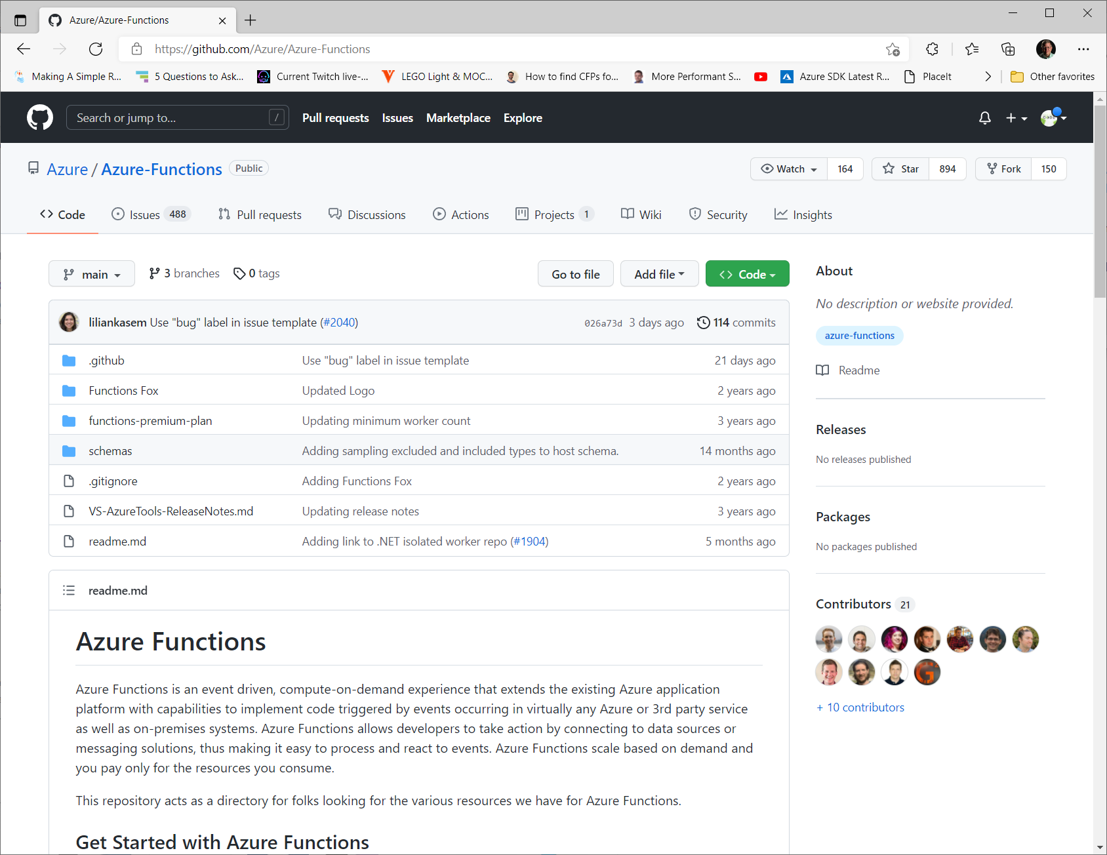
Open Source

Slide 52











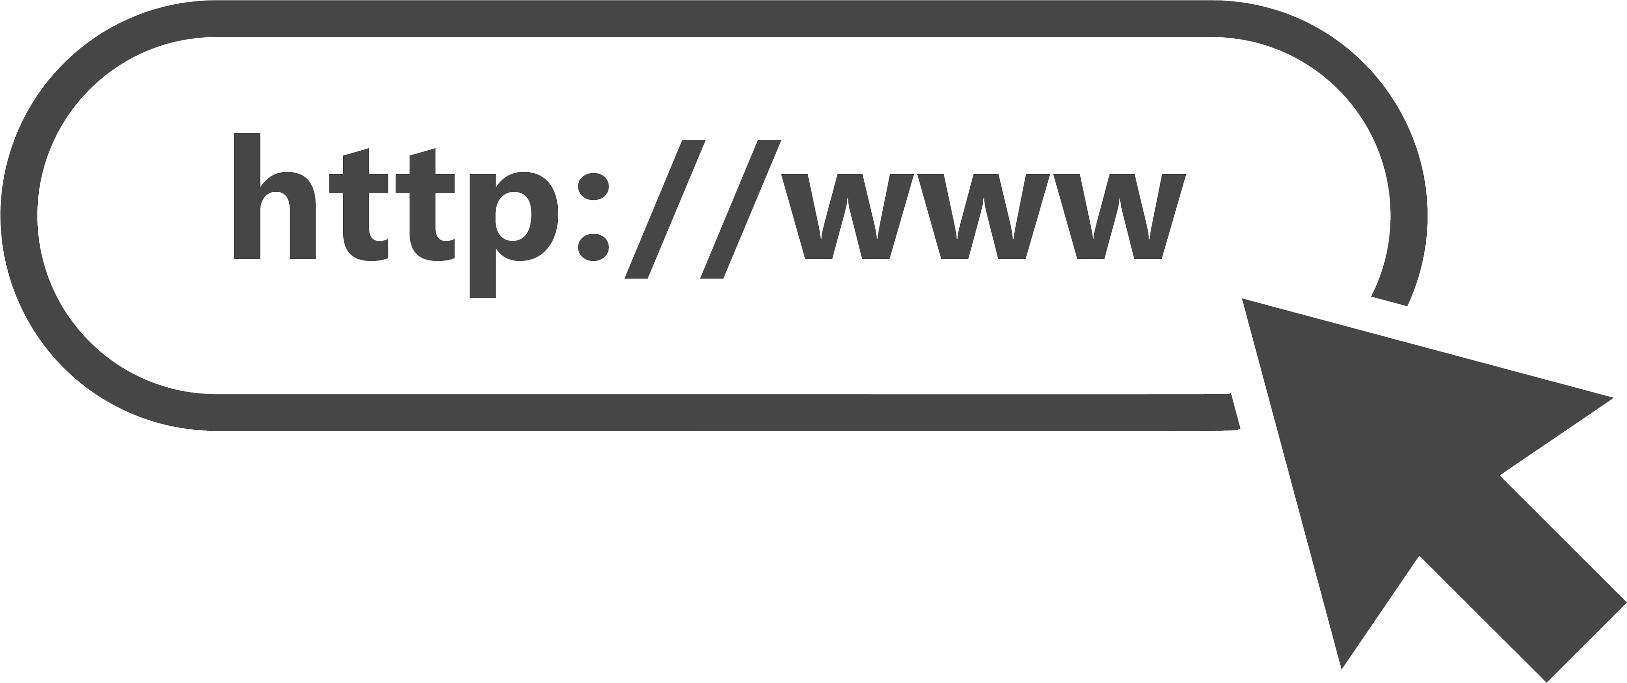





Supported Triggers and Bindings
Third Party Bindings
Custom Bindings

Slide 53

Azure Key Vault

Slide 54
Problems Solved
Secrets Management
Key Management
Certificate Management
Notes:
Secrets Management - Azure Key Vault can be used to Securely store and tightly control access to tokens, passwords, certificates, API keys, and other secrets
Key Management - Azure Key Vault can be used as a Key Management solution. Azure Key Vault makes it easy to create and control the encryption keys used to encrypt your data.
Certificate Management - Azure Key Vault lets you easily provision, manage, and deploy public and private Transport Layer Security/Secure Sockets Layer (TLS/SSL) certificates for use with Azure and your internal connected resources.

Slide 55
Why use Azure Key Vault
Centralized application secrets
Notes:
Centralizing storage of application secrets in Azure Key Vault allows you to control their distribution. Key Vault greatly reduces the chances that secrets may be accidentally leaked. When application developers use Key Vault, they no longer need to store security information in their application. Not having to store security information in applications eliminates the need to make this information part of the code. For example, an application may need to connect to a database. Instead of storing the connection string in the app's code, you can store it securely in Key Vault.
Your applications can securely access the information they need by using URIs. These URIs allow the applications to retrieve specific versions of a secret. There's no need to write custom code to protect any of the secret information stored in Key Vault.

Slide 56
Why use Azure Key Vault
Centralized application secrets
Securely store secrets and keys
Notes:
Access to a key vault requires proper authentication and authorization before a caller (user or application) can get access. Authentication establishes the identity of the caller, while authorization determines the operations that they're allowed to perform.
Authentication is done via Microsoft Entra ID. Authorization may be done via Azure role-based access control (Azure RBAC) or Key Vault access policy. Azure RBAC can be used for both management of the vaults and access data stored in a vault, while key vault access policy can only be used when attempting to access data stored in a vault.
Azure Key Vaults may be either software-protected or, with the Azure Key Vault Premium tier, hardware-protected by hardware security modules (HSMs). Software-protected keys, secrets, and certificates are safeguarded by Azure, using industry-standard algorithms and key lengths. For situations where you require added assurance, you can import or generate keys in HSMs that never leave the HSM boundary. Azure Key Vault uses nCipher HSMs, which are Federal Information Processing Standards (FIPS) 140-2 Level 2 validated. You can use nCipher tools to move a key from your HSM to Azure Key Vault.
Finally, Azure Key Vault is designed so that Microsoft doesn't see or extract your data.

Slide 57
Why use Azure Key Vault
Centralized application secrets
Securely store secrets and keys
Monitor access and use
Notes:
Once you've created a couple of Key Vaults, you'll want to monitor how and when your keys and secrets are being accessed. You can monitor activity by enabling logging for your vaults. You can configure Azure Key Vault to:
Archive to a storage account.
Stream to an event hub.
Send the logs to Azure Monitor logs.
You have control over your logs and you may secure them by restricting access and you may also delete logs that you no longer need.

Slide 58
Why use Azure Key Vault
Centralized application secrets
Securely store secrets and keys
Monitor access and use
Simplified administration of application secrets
Notes:
When storing valuable data, you must take several steps. Security information must be secured, it must follow a life cycle, and it must be highly available. Azure Key Vault simplifies the process of meeting these requirements by:
Removing the need for in-house knowledge of Hardware Security Modules.
Scaling up on short notice to meet your organization's usage spikes.
Replicating the contents of your Key Vault within a region and to a secondary region. Data replication ensures high availability and takes away the need of any action from the administrator to trigger the failover.
Providing standard Azure administration options via the portal, Azure CLI and PowerShell.
Automating certain tasks on certificates that you purchase from Public CAs, such as enrollment and renewal.
In addition, Azure Key Vaults allow you to segregate application secrets. Applications may access only the vault that they're allowed to access, and they can be limited to only perform specific operations. You can create an Azure Key Vault per application and restrict the secrets stored in a Key Vault to a specific application and team of developers.

Slide 59
Why use Azure Key Vault
Centralized application secrets
Securely store secrets and keys
Monitor access and use
Simplified administration of application secrets
Integrate with other Azure services
Notes:
As a secure store in Azure, Key Vault has been used to simplify scenarios like:
Azure Disk Encryption
The always encrypted and Transparent Data Encryption functionality in SQL Server and Azure SQL Database
Azure App Service
Key Vault itself can integrate with storage accounts, event hubs, and log analytics.

Slide 60

Azure App Configuration
Notes:
Azure App Configuration provides a service to centrally manage application settings and feature flags. Modern programs, especially programs running in a cloud, generally have many components that are distributed in nature. Spreading configuration settings across these components can lead to hard-to-troubleshoot errors during an application deployment. Use App Configuration to store all the settings for your application and secure their accesses in one place.

Slide 61
Benefits
Full managed service that can be set up in minutes
Flexible key representations and mappings
Tagging with labels
Dedicated UI for feature flag management
Enhanced security through Azure-managed identities
Encryption of sensitive information at rest and in transit
Native integration with popular frameworks

Slide 62
Providers, Builders, and Clients
Programming language and framework | How to connect
.NET Core | App Configuration
ASP.NET Core | App Configuration provider for .NET Core
.NET Framework and ASP.NET | App Configuration builder for .NET
Java Spring | App Configuration provider for Spring Cloud
JavaScript/Node.js | App Configuration client for JavaScript
Python | App Configuration client for Python
Other | App Configuration REST API

Slide 63
FAQ
How is App Configuration different from Azure Key Vault?
App Configuration supports:
Hierarchical namespaces
Labeling
Extensive queries
Batch retrieval
Specialized management operations
A feature-management user interface
Notes:
App Configuration helps developers manage application settings and control feature availability. It aims to simplify many of the tasks of working with complex configuration data.
App Configuration supports:
Hierarchical namespaces
Labeling
Extensive queries
Batch retrieval
Specialized management operations
A feature-management user interface
App Configuration complements Key Vault, and the two should be used side by side in most application deployments.

Slide 64
FAQ
Should I store secrets in App Configuration?
No
Notes:
Although App Configuration provides hardened security, Key Vault is still the best place for storing application secrets. Key Vault provides hardware-level encryption, granular access policies, and management operations such as certificate rotation.
You can create App Configuration values that reference secrets stored in Key Vault.

Slide 65
FAQ
Does App Configuration encrypt my data?
Yes
Notes:
Yes. App Configuration always encrypts all data in transit and at rest. All network communication is over TLS 1.2 or TLS 1.3. App Configuration supports encryption at rest with either Microsoft-managed keys or customer-managed keys.

Slide 66
FAQ
How is App Configuration different from Azure App Service settings?
Notes:
Azure App Service allows you to define app settings for each App Service instance. These settings are passed as environment variables to the application code. You can associate a setting with a specific deployment slot, if you want.
In contrast, Azure App Configuration allows you to define settings that can be shared among multiple apps. This includes apps running in App Service, as well as other platforms. Your application code accesses these settings through the configuration providers for .NET and Java, through the Azure SDK, or directly via REST APIs.
You can add references to your App Configuration data in the Application settings of your App Service.
You can also import and export settings between App Service and App Configuration.

Slide 67
FAQ
Are there any size limitations on keys and values stored in App Configuration?
10 Kb
Notes:
There's a limit of 10 KB for a single key-value, including attributes such as label, content-type, tags, and other metadata.

Slide 68
FAQ
How should I store configurations for multiple environments (test, staging, production, and so on)?
Notes:
You control who can access App Configuration at a per-store level. Use a separate store for each environment that requires different permissions. This approach provides the best security isolation.
If you don't need security isolation between environments, you can use labels to differentiate between configuration values.

Slide 69
FAQ
Where does data stored in App Configuration reside?
Notes:
Customer data stored in App Configuration reside in the region where the customer's App Configuration store was created. Customer data will be replicated to another region only if the customer enables geo-replication for that region. This applies to all available regions. Customers may move, copy, or access their data from any location globally.

Slide 70
FAQ
Are there any limits on the number of requests made to App Configuration?
Tier | Request Limit
Free | 1,000 per day
Standard | 30,000 per hour
Notes:
Configuration stores in the Free tier are limited to 1,000 requests per day. Configuration stores in the Standard tier may experience temporary throttling when the request rate exceeds 30,000 requests per hour.
When a store reaches its limit in the standard tier, it may return HTTP status code 429 for some requests made until the end of the hour. The retry-after-ms header in the response gives a suggested wait time (in milliseconds) before retrying the request.

